Slide 1



Java basics
Session
2
Chaim Turkel
Ido Barash

Slide 2


Last session
Introduction
The JVM
Java simple class
Variables
Conditions
Loops
Methods
Enumerations
Javadocs & Comments

Slide 3
Java basics - 2
Inheritance
Interfaces
Interface VS Abstract class
casting
Polymorphism

Slide 4

Inheritance
Relationship between a superclass and subclasses.
Classes can inherit attributes and behavior from other class.
Inheritance creates hierarchy between classes
Inheritance helps us to write less code (use parent’s)
Inheritance is part of the “hide” of object oriented approach Parent class is also called super class or base class.
Sub classes are also called derived classes or children classes.
Subclasses can add new functionality, use inherited functionality or override inherited functionality.

Slide 5

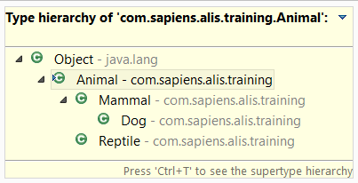



Inheritance
In Java - inheritance is established by using the “extends” keyword.
Every Class automatically extends the Object class.
Java does not allow multiple inheritance (only one superclass)
Notes:
5

Slide 6
Inheritance - encapsulation
Encapsulation is one of the fundamentals of OOP.
A protective barrier that prevents access to the code and data of the class by other code from outside the class.
It achieved using access modifiers: public, private and protected.
No access modifier will make the data visible to any class within the same package.
Notes:
6

Slide 7



Inheritance - encapsulation
Private field:
Can be accessed within the class only.
Public method:
Can be accessed from everywhere
Protected method :
Can be accessed from the class or from a subclass.
Notes:
7

Slide 8
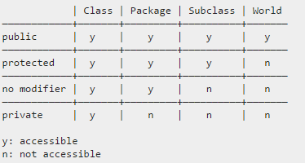
Inheritance - encapsulation
Package modifier is important for unit testing – you can access all protected methods and variables without inheritence
Notes:
8

Slide 9
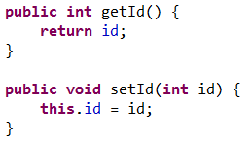
Inheritance - encapsulation
Private fields are usually accessed by public getters and setters methods.
Benefits of encapsulation:
Fields can be made read-only , write-only or not accessible at all.
A class cab have total control over it’s fields.
A user of a class does not know how the class stores data.
Notes:
9

Slide 10
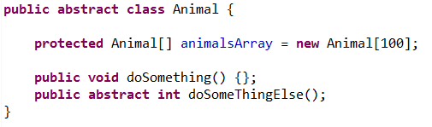
Inheritance - abstract
Abstract Class
Can not be instantiated. Can only be extended.
Defines a default behavior and default members .
Abstract method
declares a method with no body which a subclass in the hierarchy must implement.
Notes:
10

Slide 11
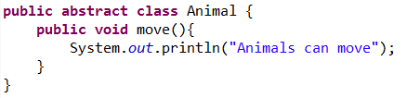
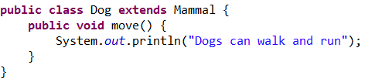
Inheritance - override
A subclass can implement a new behavior instead of one inherited by superclass.
The benefit of overriding: ability to define a specific personal behavior for a subclass.
Notes:
11

Slide 12
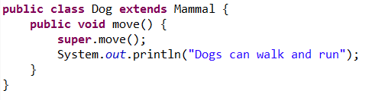
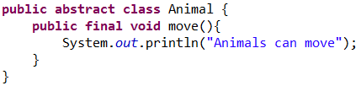
Inheritance - override
In order to use superclass method, even though it was overriden, we use the keyword “super”
A method declared with the keyword “final” can not be overridden.
Notes:
12

Slide 13
Inheritance – override
Overriding rules:
Arguments list must be the same as overridden method’s arguments list.
Return type must be the same as overridden method’s return type.
Access level of overridden class can not be more restrictive.
A final method can not be overridden.
A method that can not be inherited, can not be overridden.
Notes:
13

Slide 14
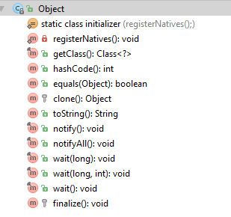
Inheritance – Object class
The java.lang.Object class sits at the top of the class hierarchy tree.
Every class is descendant, direct or indirect, of the Object class.
Object class declares instance method that can be used as is or overridden by subclasses.
Object clone() – returns a copy of the object (non deep).
boolean equals(Object obj) – indicates if another object is equal to this object. If not overridden, it will compare memory addresses.
Void finalize() – called by the GC.
Class getClass() – returnes the runtime class of the Object.
Int hashCode() - returnes a has code of an object.
String toString() – returnes a string representation of he object.
Threads methods: void notify(), void notiffyAll(), void wait()
Notes:
14

Slide 15
Inheritance – multiple
Why doesn’t Java support multiple inheritance?
Notes:
15

Slide 16
Inheritance – multiple
Why doesn’t Java support multiple inheritance?
For the sake of simplicity
Complicates the design
Constructor chaining
The diamond problem
A
F()
override F()
B
C
Inherit F()
D
? F()
Notes:
16

Slide 17

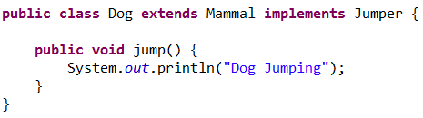
Interfaces
An interface is a collection of abstract methods and constant fields.
A class which implements an interface, inherits the abstract methods of the interface, and must provide an implementation of these methods.
Notes:
17

Slide 18
Interfaces
An interface is a collection of abstract methods and constant fields.
A class which implements an interface, inherits the abstract methods of the interface, and must provide an implementation of these methods.
Notes:
18

Slide 19
Interfaces
An interface can not be instantiated.
An interface can not contain constructors.
All methods of the interface are abstract.
A class doesn’t extend an interface – it implements it.
An interface can extend multiple interfaces.
A class can implement multiple interfaces.
Notes:
19

Slide 20
Interfaces vs abstract
What is the difference between an interface and an abstract class?
Notes:
20

Slide 21
Interfaces vs abstract
What is the difference between an interface and an abstract class? They are both quite similar and used to declare a class template, but there are several important differences:
An abstract class allows us to provide a default implementation for a method.
A class can implement multiple interfaces but extend only one abstract class.
An interface can not declare private members.
Use an interface as a contract to define a behavior.
Use abstract class as a part of inheritance and code reuse.
Notes:
21

Slide 22


Casting
Casting – treat an object as another type.
Primitive casting –
Treat integer as double
Treat double as integer (loose fraction point)
Notes:
22

Slide 23
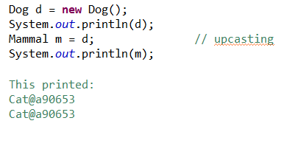
Casting
Upcasting:
treat an object as one of it’s super types or implemented interfaces.
This is done automatically (without any declarations).
Notes:
23

Slide 24
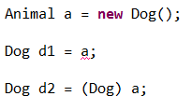
Casting
Downcasting:
treat an object as one of it’s subclasses.
Requires explicit declaration.
Notes:
24

Slide 25
Polymorphism
The ability of an object to take the forms of it’s super-classes or implemented interfaces.
In OOP - A superclass or an interface reference is used to refer a subclass object.
Any Object that can pass one or more IS-A tests, is polymorphic.
In Java, all objects are polymorphic – they all extend the class Object.
If an object of a Type is referenced by a superclass type, only the methods of the superclass (or the interface) will be accessible.
Notes:
25

Slide 26

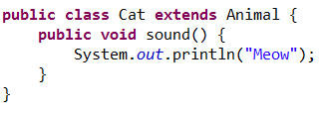
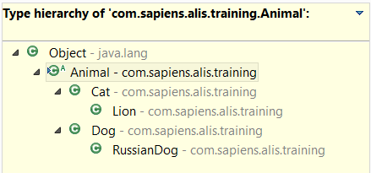
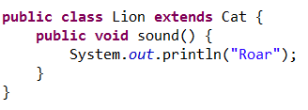
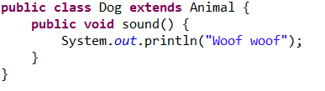
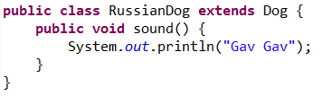
Polymorphism
Notes:
26

Slide 27
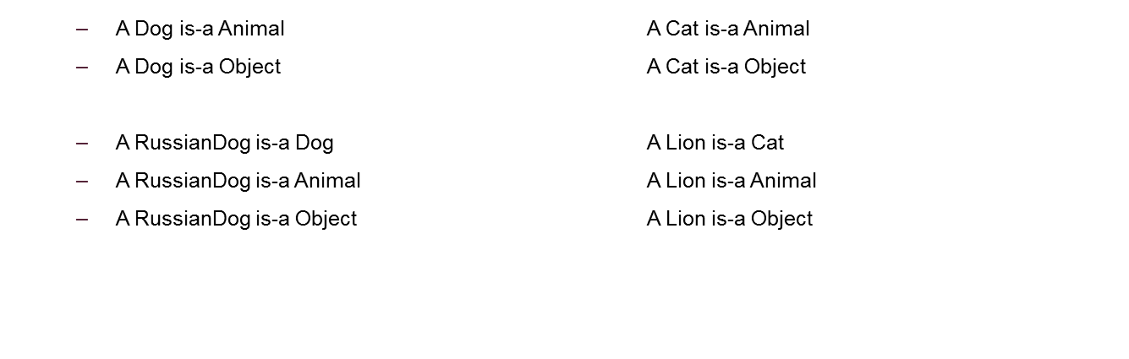
Polymorphism
Notes:
27

Slide 28
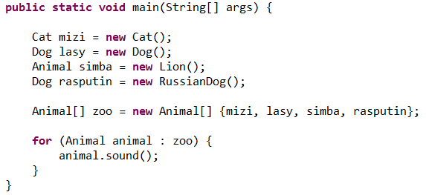
Polymorphism
Notes:
28

Slide 29

Polymorphism
Notes:
29

Slide 30
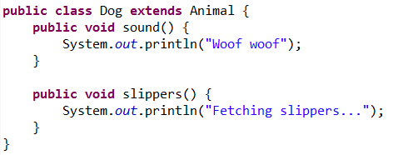
Polymorphism
Notes:
30

Slide 31
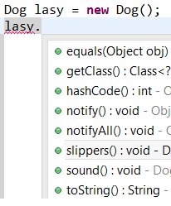
Polymorphism
Notes:
31

Slide 32
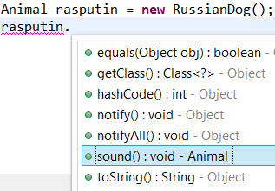
Polymorphism
Notes:
32

Slide 33
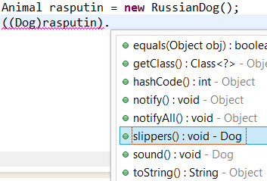
Polymorphism
Notes:
33

Slide 34
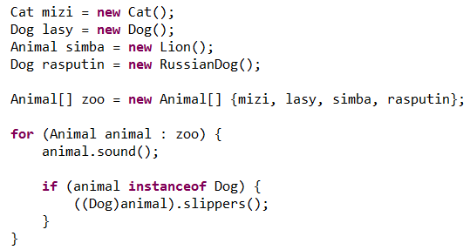
Polymorphism – instanceof
In polymorphism, we can go over an array of Objects with a super’s reference.
Sometimes we need to handle types differently.
We can check if an object behind a super-class reference is an actually of a specific type using the operator “instanceof”.
Notes:
34

Slide 35

Polymorphism – question
Lets say we have a class A with a method send() and a class B which extends A. Suddenly – a compilation error: Why?
Notes:
35

Slide 36
Polymorphism – question
Lets say we have a class A with a method send() and a class B which extends A. Suddenly – a compilation error: Why?
The method send() is private - should be public or protected
The method send is static – should be used as B.send()
The method send() in A is abstract and B didn’t provide an implementation.
Notes:
36

Slide 37


THANK YOU
Chaim Turkel
Email: chaim@tikalk.com

